Slide 1
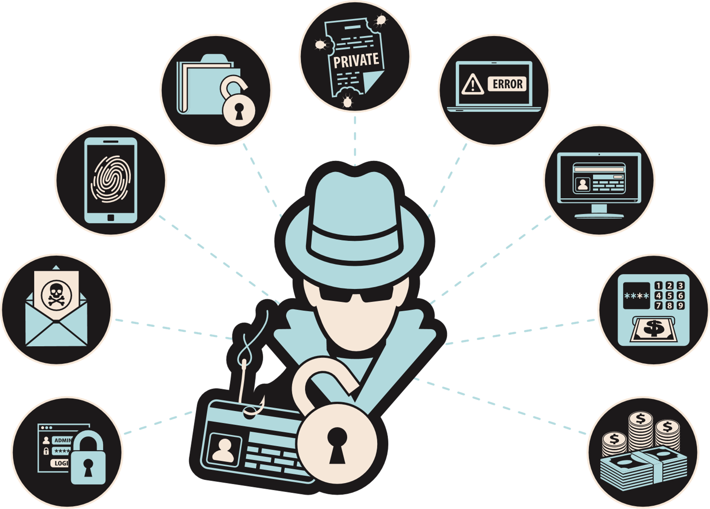
OBJECTIVES
By the end of this lesson, students will be able to:
PHISHING AWARENESS & PROTECTION
PHISHING 101
3
1
Think Before You Click!
Develop critical thinking skills to discern legitimate requests from potential phishing attempts
Define phishing and identify common methods used by scammers
MUHAMMAD SALEEM
2
Recognize red flags in phishing emails, messages, or posts

Slide 2


OBJECTIVES
WHAT IS PHISHING?
By the end of this lesson, students will be able to:
1
2
3
Phishing is when someone tries to trick you into revealing personal information like your password, credit card numbers, or social security number.
Phishing can happen through emails, text messages, or other online platforms.
Define phishing and identify common methods used by scammers
Recognize red flags in phishing emails, messages, or posts
Develop critical thinking skills to discern legitimate requests from potential phishing attempts
Think of an email or message you received that asked for personal information. What made it suspicious?

Slide 3



TYPES OF PHISHING
Phishing attacks come in different forms
WHAT IS PHISHING?
Phishing is when someone tries to trick you into revealing personal information like your password, credit card numbers, or social security number.
Phishing can happen through emails, text messages, or other online platforms.
EMAIL PHISHING
SMS PHISHING
SOCIAL MEDIA PHISHING
Scammers send fake emails pretending to be a trustworthy organization
Scammers send text messages with fake links or requests for personal information
Think of an email or message you received that asked for personal information. What made it suspicious?
Scammers create fake profiles or posts to trick you into clicking on links or sharing personal information

Slide 4

RED FLAGS
TYPES OF PHISHING
Red flags in phishing attempts are warning signs or indicators that help individuals identify potential scams. Some common read flags in phishing include:
Phishing attacks come in different forms
EMAIL PHISHING
SMS PHISHING
SOCIAL MEDIA PHISHING
Scammers send fake emails pretending to be a trustworthy organization
Scammers send text messages with fake links or requests for personal information
Scammers create fake profiles or posts to trick you into clicking on links or sharing personal information
1
Urgent or threatening language
2
Suspicious sender information
3
Requests for personal information
4
Misspellings or grammatical errors
5
Suspicious links or attachments
6
Generic greetings
7
Too good to be true

Slide 5

01
URGENT OR THREATENING LANGUAGE
Phishing attempts often create a sense of urgency or use threatening language to prompt immediate action. Phases like "urgent action required," "account suspended," or "your account will be deleted" may indicate a phishing attempt.
RED FLAGS
Red flags in phishing attempts are warning signs or indicators that help individuals identify potential scams. Some common read flags in phishing include:
1
Urgent or threatening language
2
Suspicious sender information
3
Requests for personal information
4
Misspellings or grammatical errors
04
MISSPELLINGS OR GRAMMATICAL ERRORS
02
SUSPICIOUS SENDER INFORMATION
5
Suspicious links or attachments
Phishing emails or messages may contain misspellings, grammatical errors, or awkward phrasing. Legitimate organizations usually have professional communications and do not contain obvious errors.
Check the sender's email address or social media profile. Phishing emails or messages often use generic or suspicious email addresses that do not match the legitimate entity they claim to represent.
6
Generic greetings
7
Too good to be true
03
REQUESTS FOR PERSONAL INFORMATION
Legitimate organizations do not request personal information, such as usernames, passwords, or credit card numbers, via email, social media, or other online means. Be cautious of any request for personal information.

Slide 6
05
SUSPICIOUS LINKS OR ATTACHMENTS
07
TOO GOOD TO BE TRUE
Be cautious of links or attachments in emails or messages from unknown or untrusted sources. Hover over links to check their actual destinations, and do not click on suspicious links or download attachments that you were not expecting.
Phishing attempts may lure individuals with enticing offers, such as winning a prize or getting a huge discount. If an offer seems too good to be true, it may be a phishing attempt.
01
URGENT OR THREATENING LANGUAGE
03
REQUESTS FOR PERSONAL INFORMATION
Phishing attempts often create a sense of urgency or use threatening language to prompt immediate action. Phases like "urgent action required," "account suspended," or "your account will be deleted" may indicate a phishing attempt.
Legitimate organizations do not request personal information, such as usernames, passwords, or credit card numbers, via email, social media, or other online means. Be cautious of any request for personal information.
02
SUSPICIOUS SENDER INFORMATION
04
MISSPELLINGS OR GRAMMATICAL ERRORS
Check the sender's email address or social media profile. Phishing emails or messages often use generic or suspicious email addresses that do not match the legitimate entity they claim to represent.
Phishing emails or messages may contain misspellings, grammatical errors, or awkward phrasing. Legitimate organizations usually have professional communications and do not contain obvious errors.
Which of the seven red flags do you think is the hardest to detect? What makes you say that?
06
GENERIC GREETINGS
Phishing emails may use generic greetings like "Dear Customer" instead of addressing you by your name. Legitimate organizations often personalize their communications with your name or other relevant information.

Slide 7
EXAMPLE 1
CONSIDER THESE RED FLAGS
05
SUSPICIOUS LINKS OR ATTACHMENTS
07
TOO GOOD TO BE TRUE
You come across a pop-up window while browsing a website that asks you for your credit card information to claim a prize or discount within the next 10 minutes. The website looks legitimate, but you only have 10 minutes to submit your personal information.
Be cautious of links or attachments in emails or messages from unknown or untrusted sources. Hover over links to check their actual destinations, and do not click on suspicious links or download attachments that you were not expecting.
Phishing attempts may lure individuals with enticing offers, such as winning a prize or getting a huge discount. If an offer seems too good to be true, it may be a phishing attempt.
Read the examples and then identify which form of phishing it is and what red flags make it a phishing attempt.
06
GENERIC GREETINGS
Which of the seven red flags do you think is the hardest to detect? What makes you say that?
Phishing emails may use generic greetings like "Dear Customer" instead of addressing you by your name. Legitimate organizations often personalize their communications with your name or other relevant information.
EXAMPLE 2
You receive a message on social media from someone claiming to be a friend or family member, asking for your address and phone number. You've never met this person and don't see photos of them with your family or friends.

Slide 8

REPORT PHISHING ATTEMPTS
CONSIDER THESE RED FLAGS
EXAMPLE 1
You come across a pop-up window while browsing a website that asks you for your credit card information to claim a prize or discount within the next 10 minutes. The website looks legitimate, but you only have 10 minutes to submit your personal information.
EXAMPLE 2
If you suspect a phishing attempt, report it to a trusted adult, teacher, or the school's IT department. Please don't forward the phishing email or message to another user. You can show them on your device. Forwarding phishing emails could lead to others being phished.
Reporting phishing attempts helps protect others from falling victim to the scam.
Read the examples and then identify which form of phishing it is and what red flags make it a phishing attempt.
You receive a message on social media from someone claiming to be a friend or family member, asking for your address and phone number. You've never met this person and don't see photos of them with your family or friends.

Slide 9



THINK CRITICALLY
REPORT PHISHING ATTEMPTS
If you suspect a phishing attempt, report it to a trusted adult, teacher, or the school's IT department. Please don't forward the phishing email or message to another user. You can show them on your device. Forwarding phishing emails could lead to others being phished.
Reporting phishing attempts helps protect others from falling victim to the scam.
Be skeptical of emails, messages, or posts that seem too good to be true or too urgent. Remember, if it sounds too good to be true, it probably is!
Think before clicking on any links, sharing personal information online, or opening any suspicious attachments. Ask yourself if it seems legitimate and if you were expecting it.
Verify the authenticity of the sender and the information provided before taking any action. Trust your instincts and be cautious when sharing information online.

Slide 10
THINK CRITICALLY
THINK BEFORE YOU CLICK!
PROTECT YOURSELF FROM PHISHING
Be skeptical of emails, messages, or posts that seem too good to be true or too urgent. Remember, if it sounds too good to be true, it probably is!
Think before clicking on any links, sharing personal information online, or opening any suspicious attachments. Ask yourself if it seems legitimate and if you were expecting it.
Verify the authenticity of the sender and the information provided before taking any action. Trust your instincts and be cautious when sharing information online.
Don't share your personal information online!

Slide 11
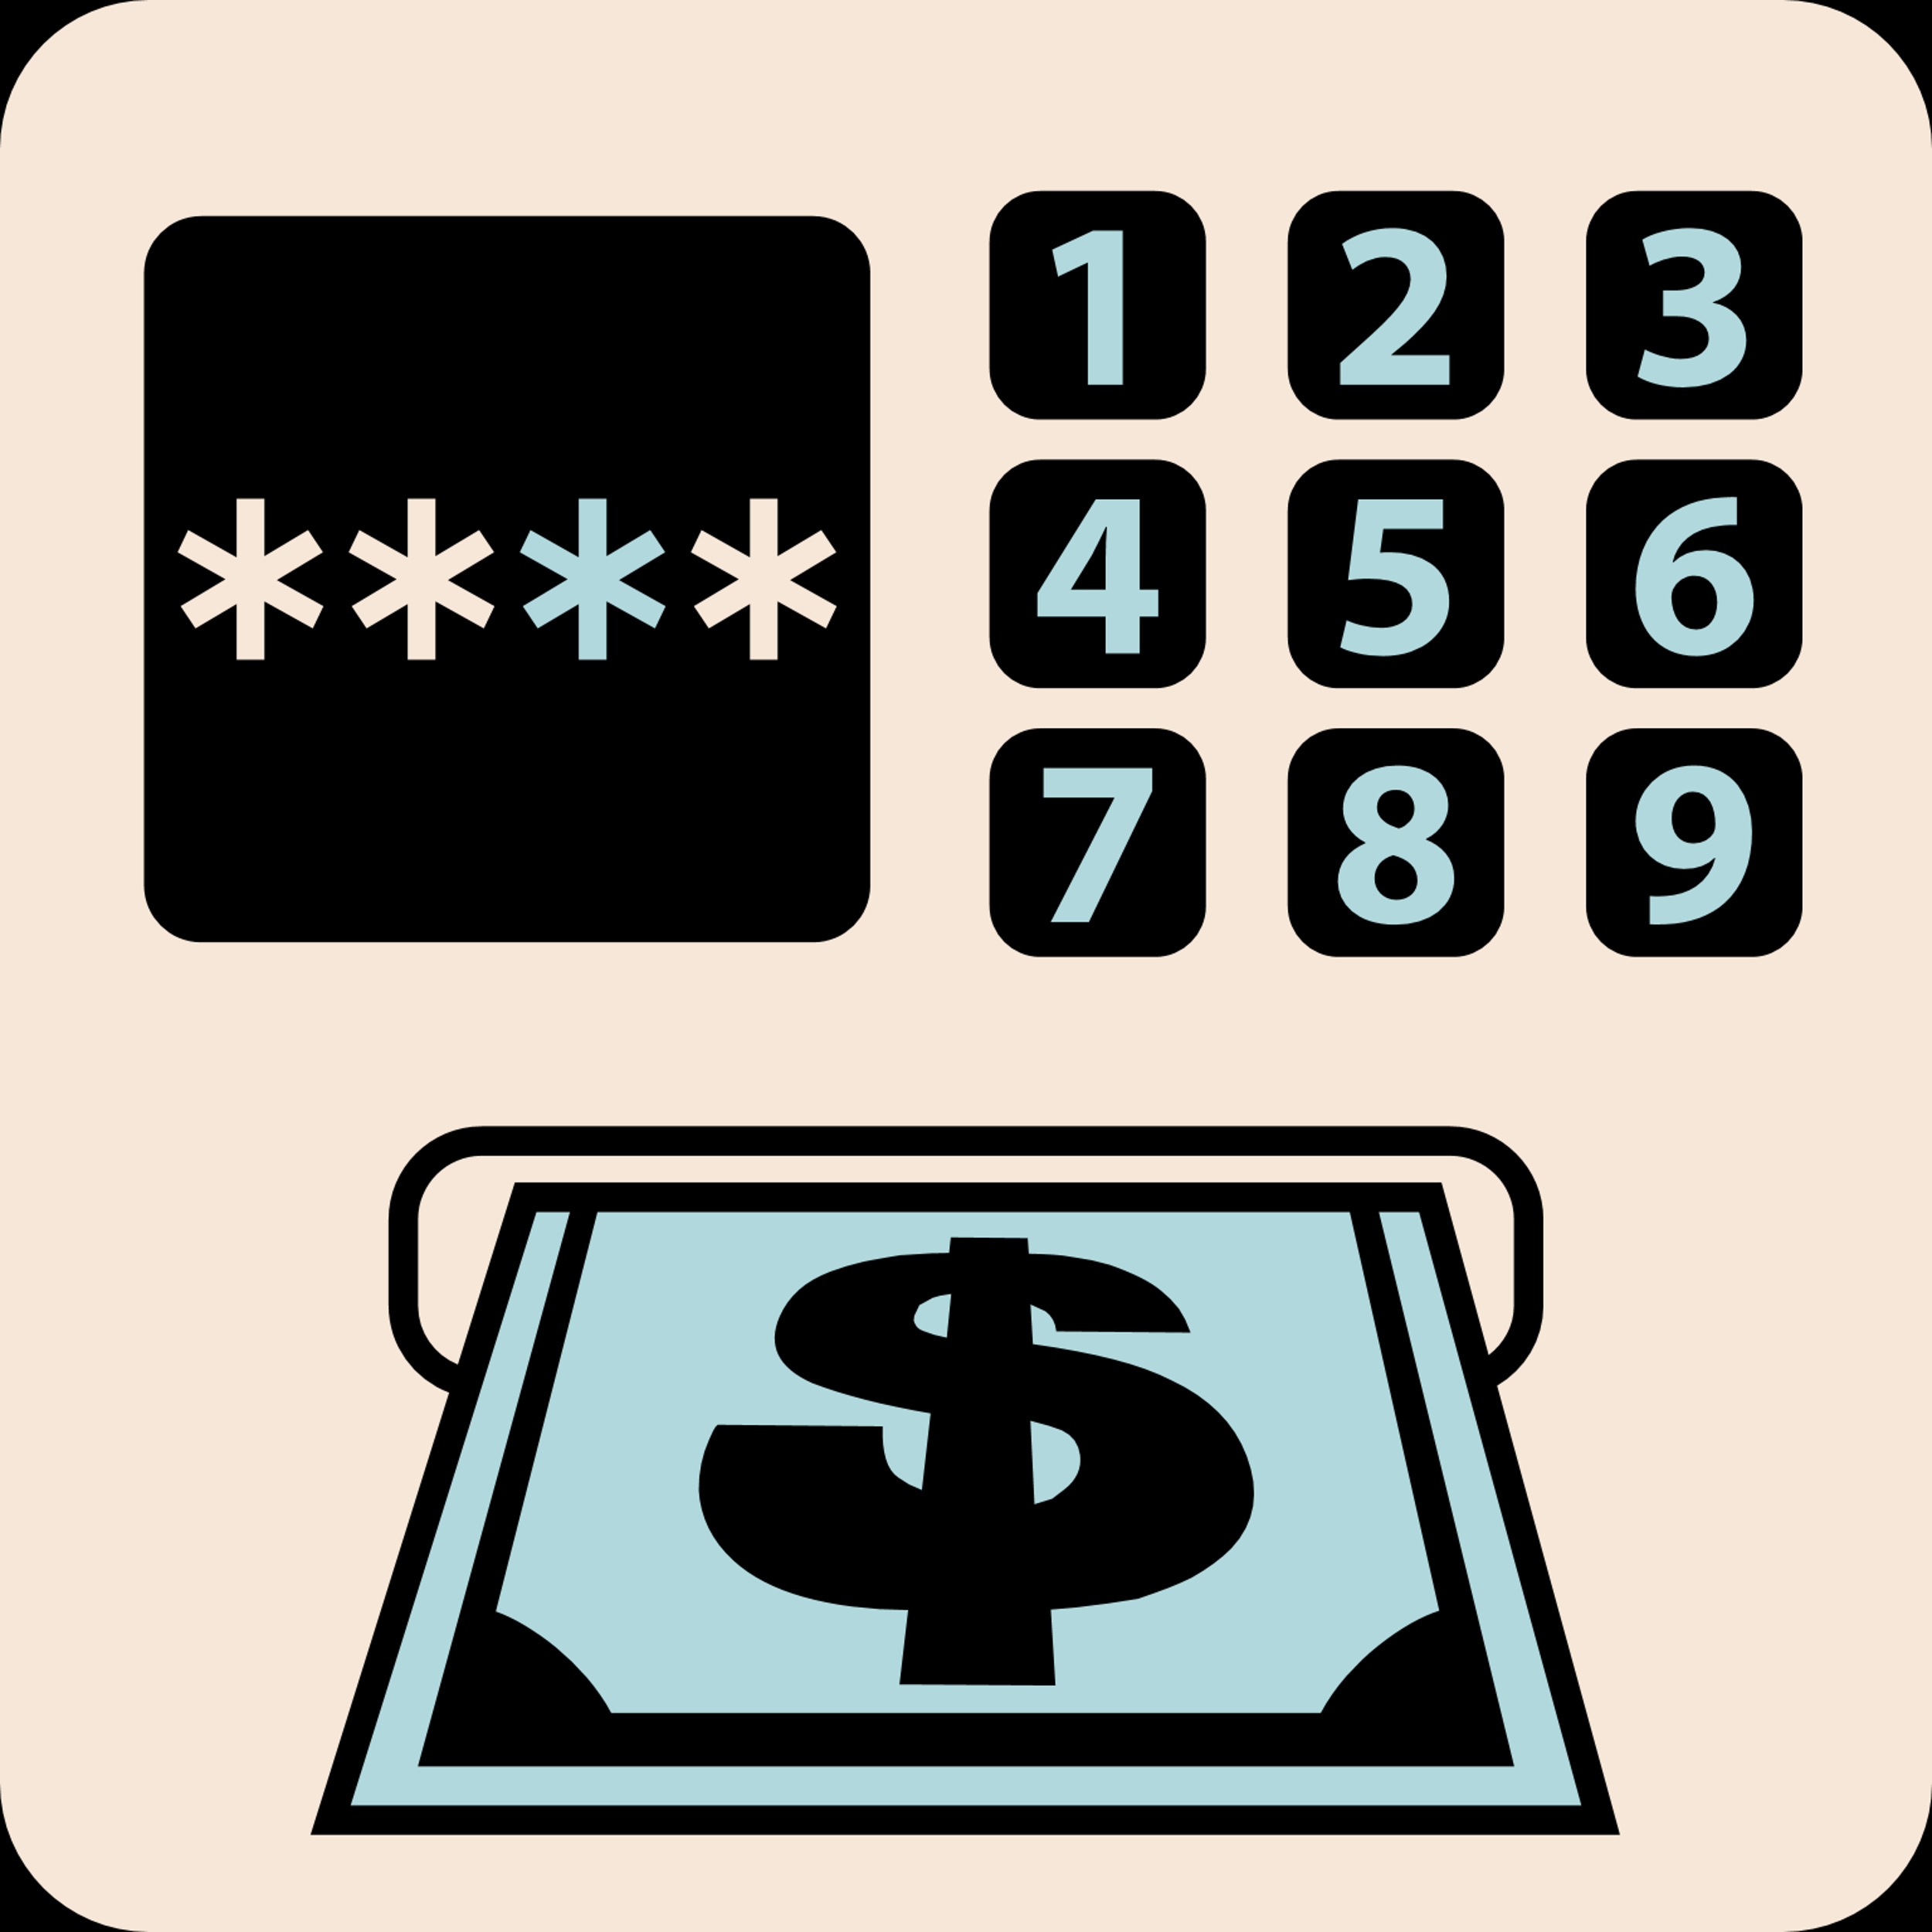



PRESENTED BY:
MUHAMMAD SALEEM
STAY SAFE. STAY SMART.
THINK BEFORE YOU CLICK!
PROTECT YOURSELF FROM PHISHING
Don't share your personal information online!

Slide 12
PRESENTED BY:
MUHAMMAD SALEEM
STAY SAFE. STAY SMART.

